Slide 1
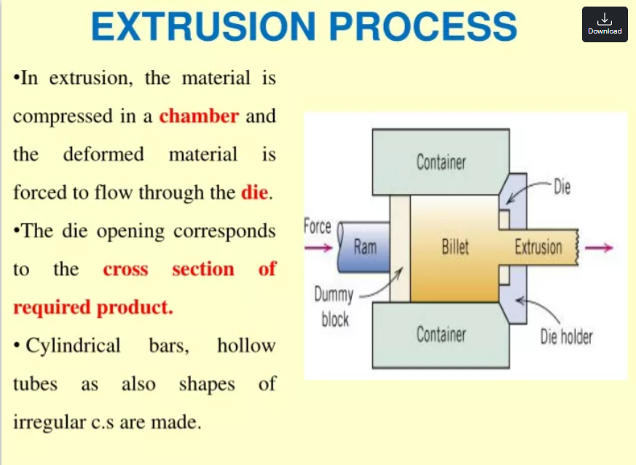

Slide 2
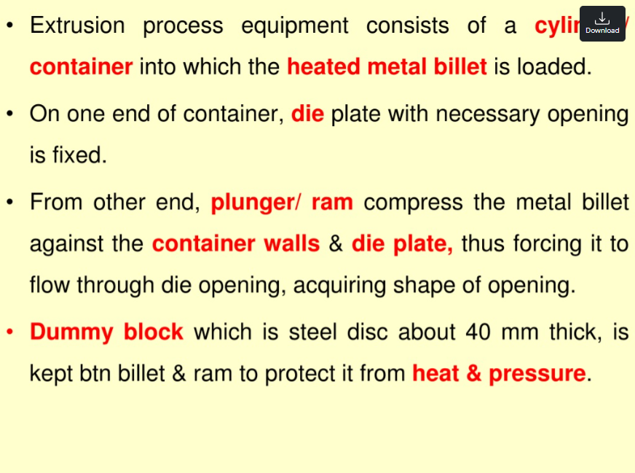

Slide 3
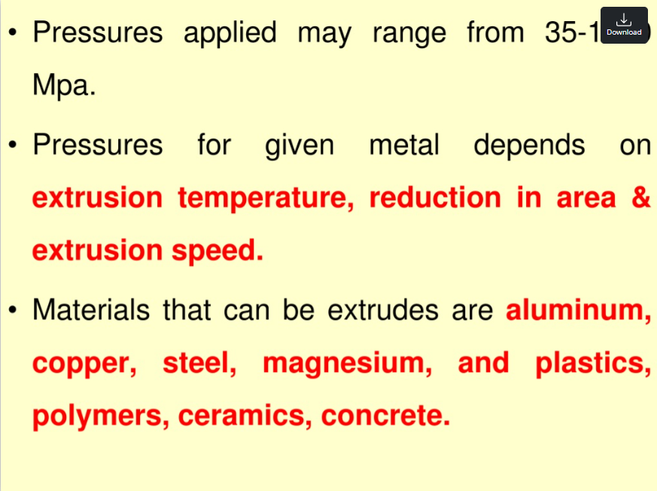

Slide 4
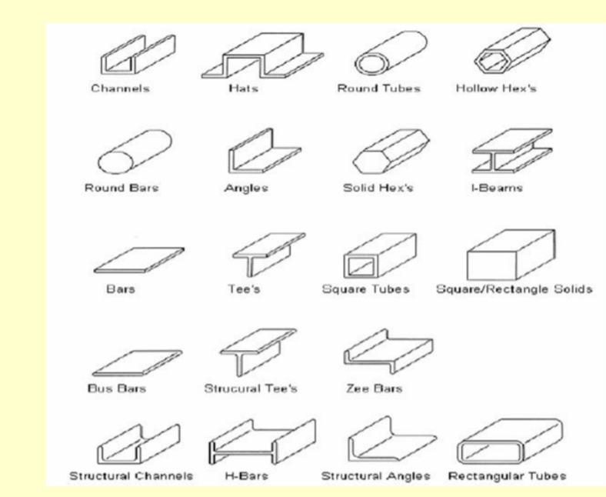

Slide 5
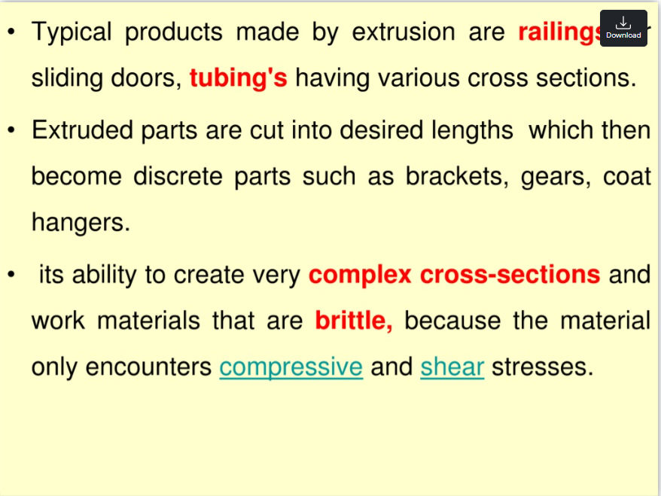

Slide 6
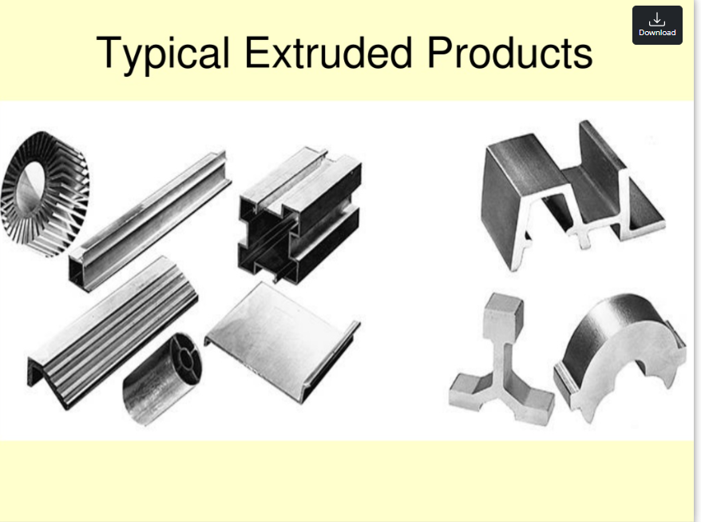

Slide 7
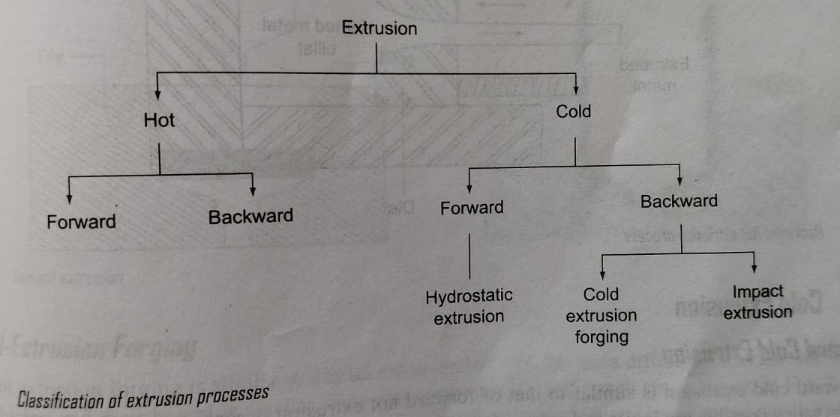

Slide 8
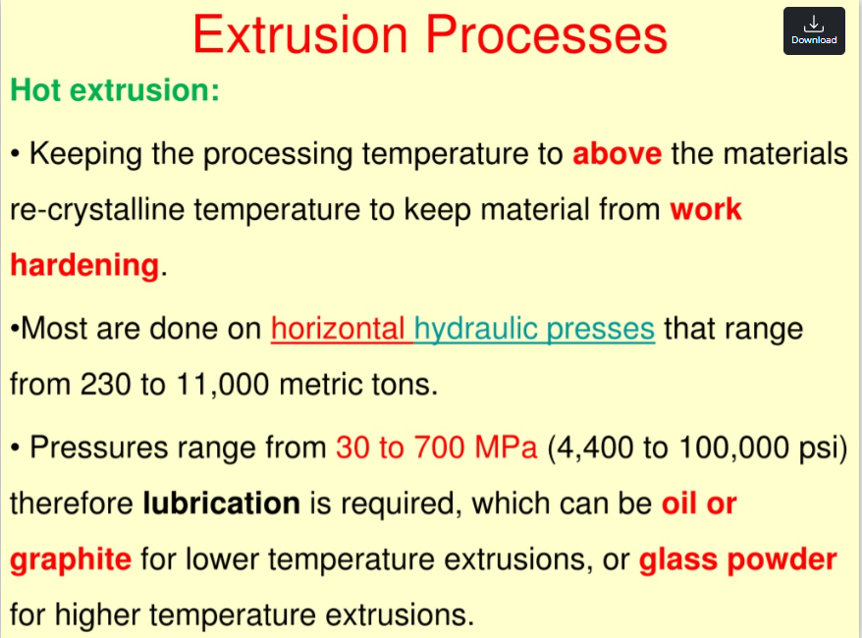

Slide 9
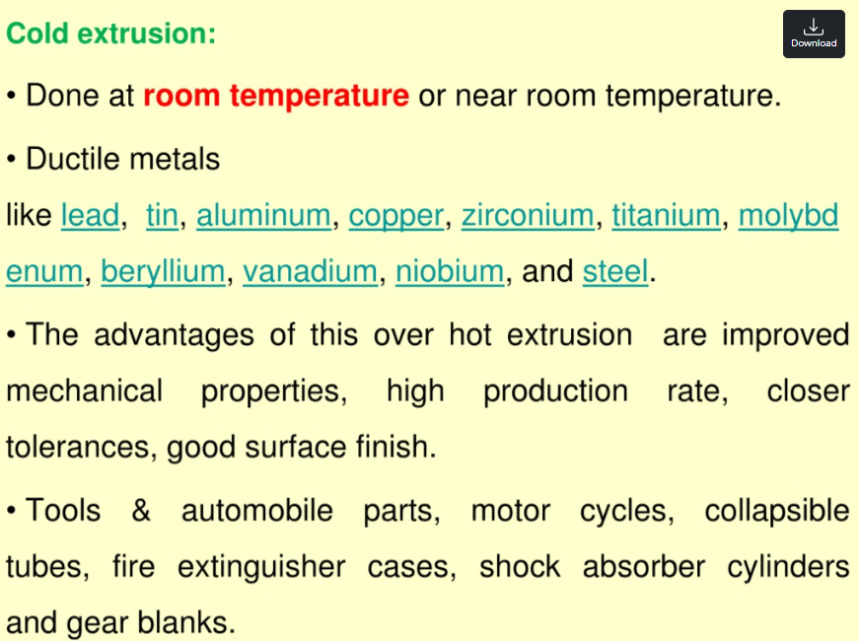

Slide 10
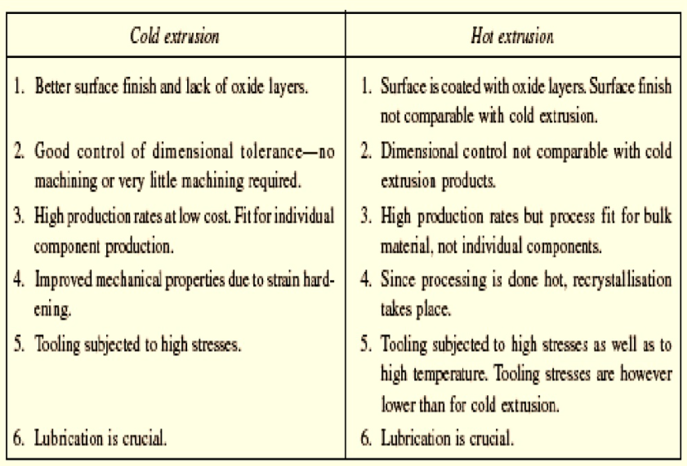

Slide 11
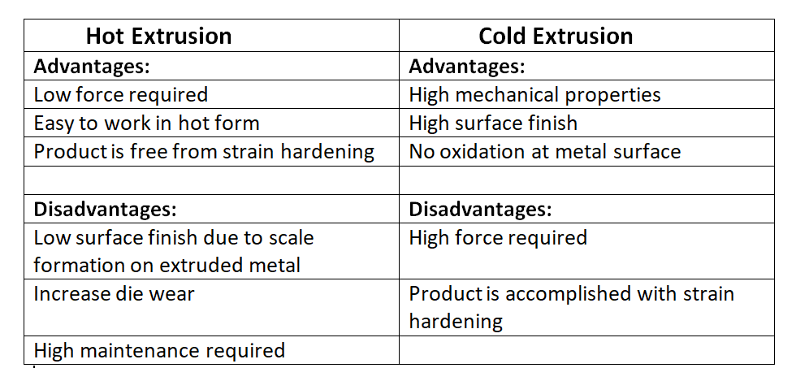

Slide 12
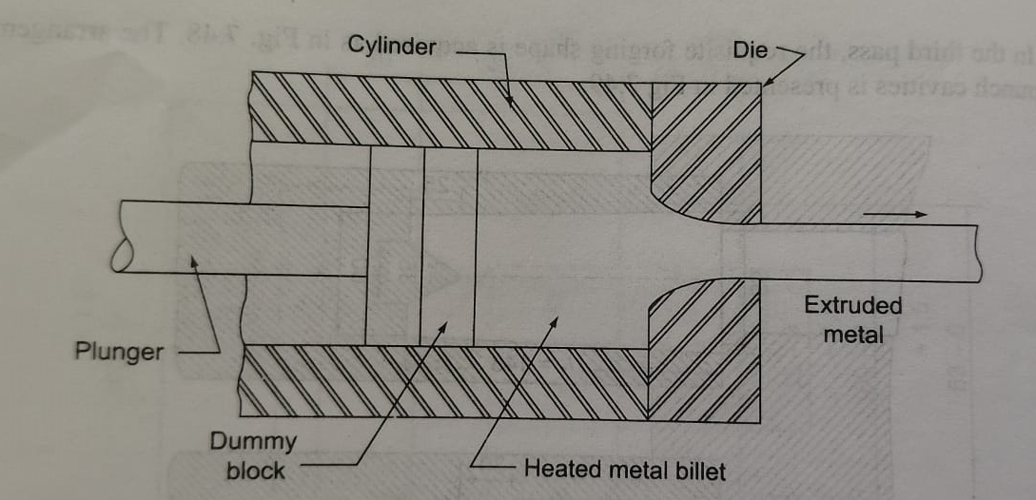
Hot Extrusion Processes
Forward Hot Extrusion:

Slide 13
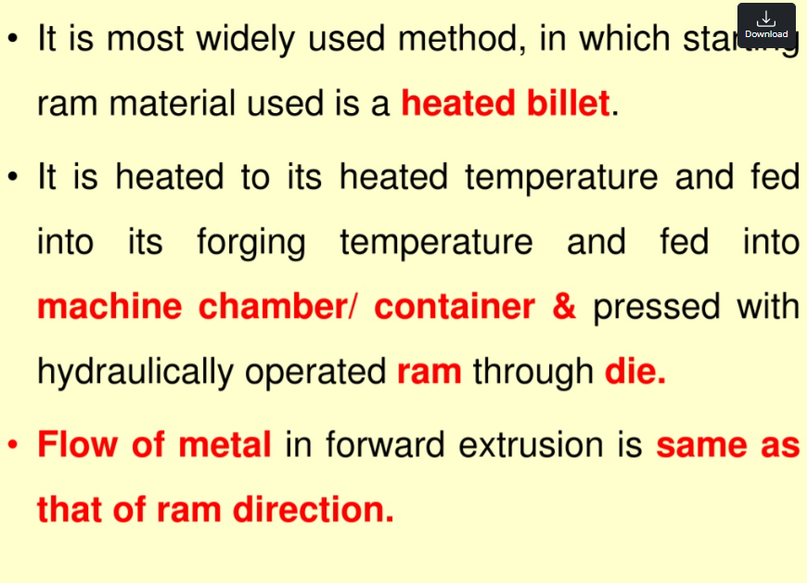

Slide 14
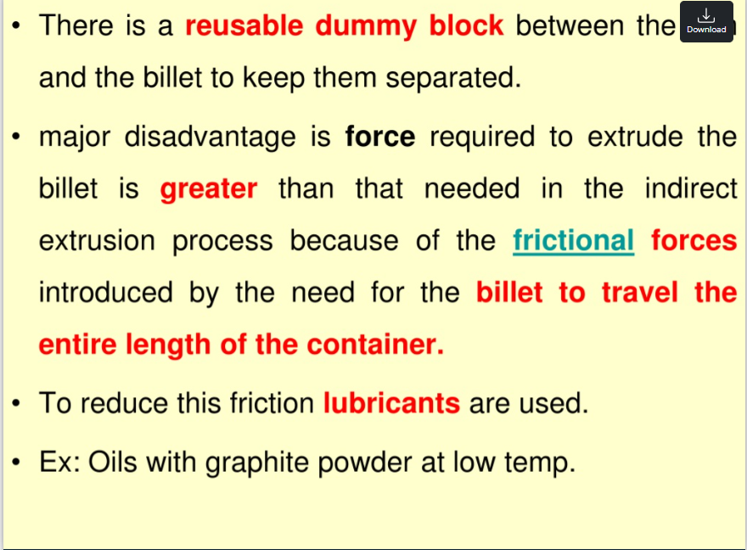

Slide 15
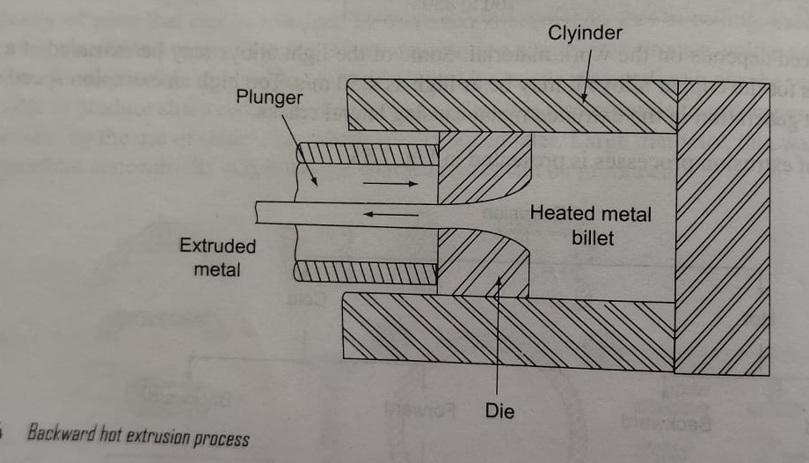
2. Backward Hot Extrusion:

Slide 16
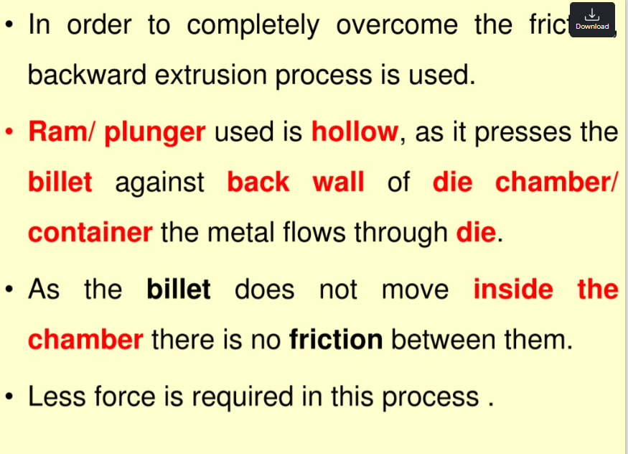

Slide 17
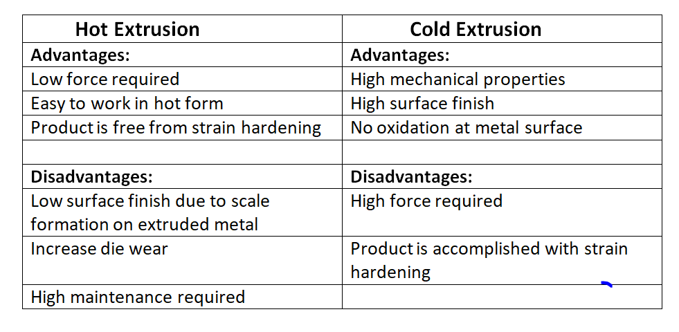

Slide 18
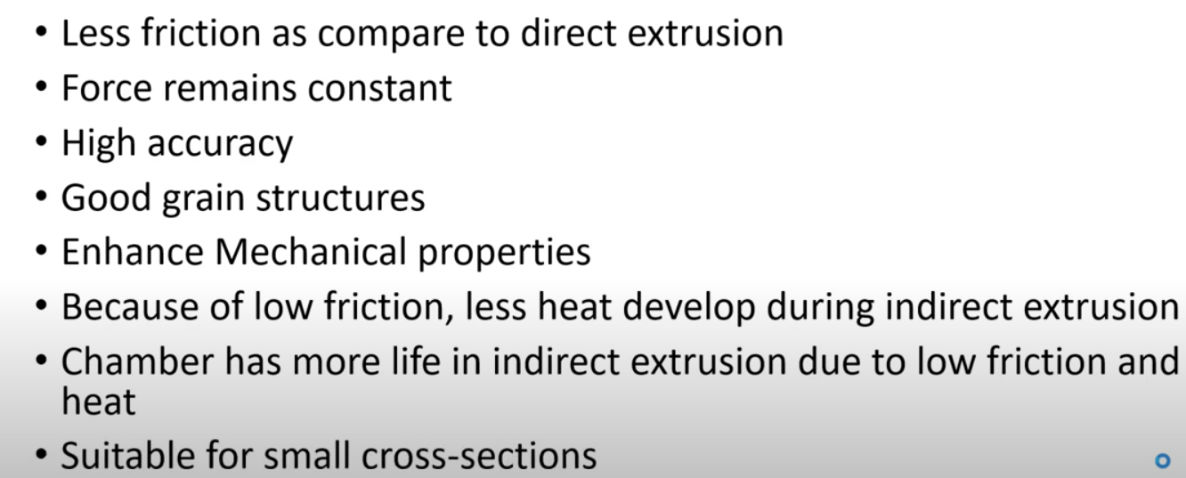
Advantages of Backward or Indirect Extrusion

Slide 19
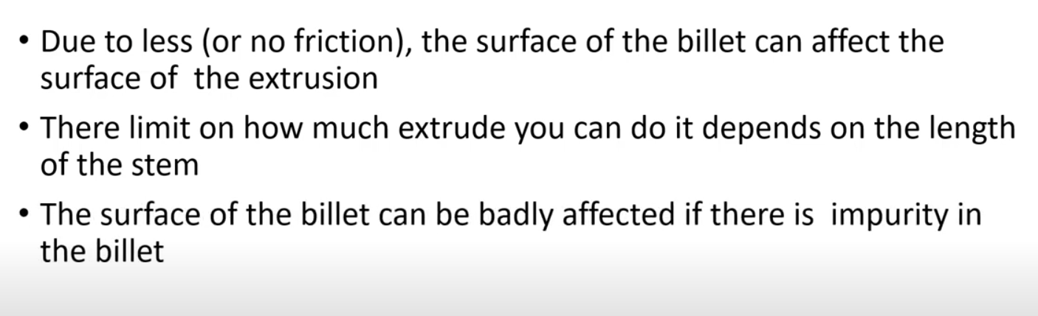
Disadvantages of Backward or Indirect Extrusion

Slide 20
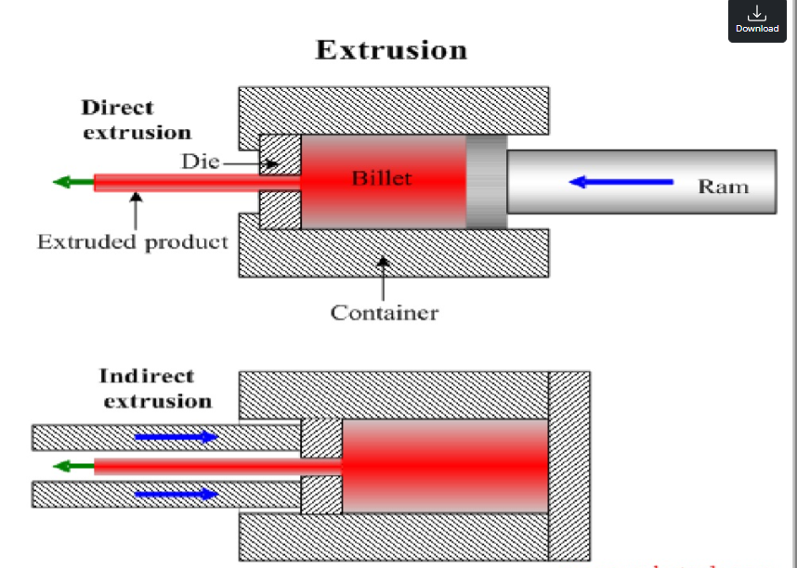

Slide 21
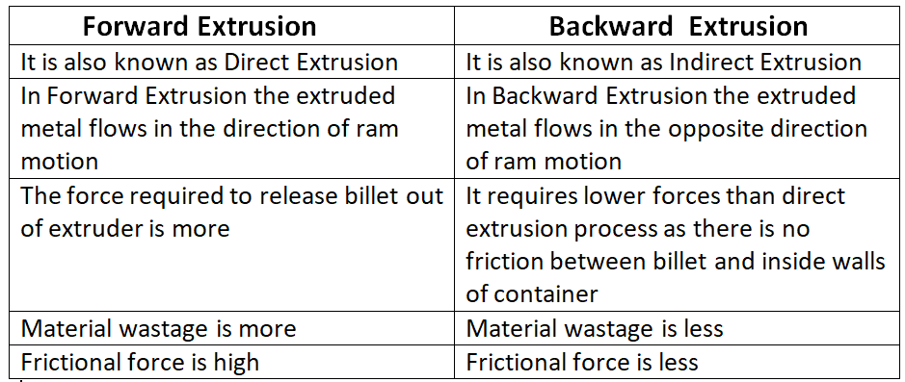

Slide 22
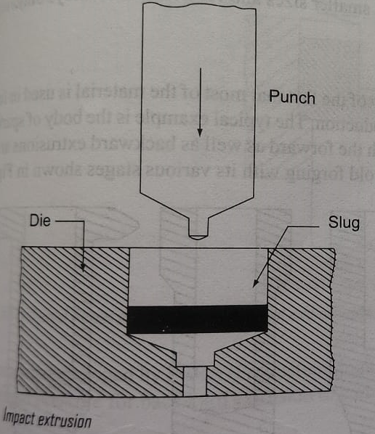
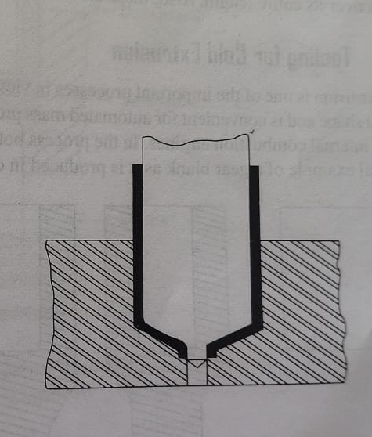
Cold Extrusion Processes
Impact Extrusion:

Slide 23
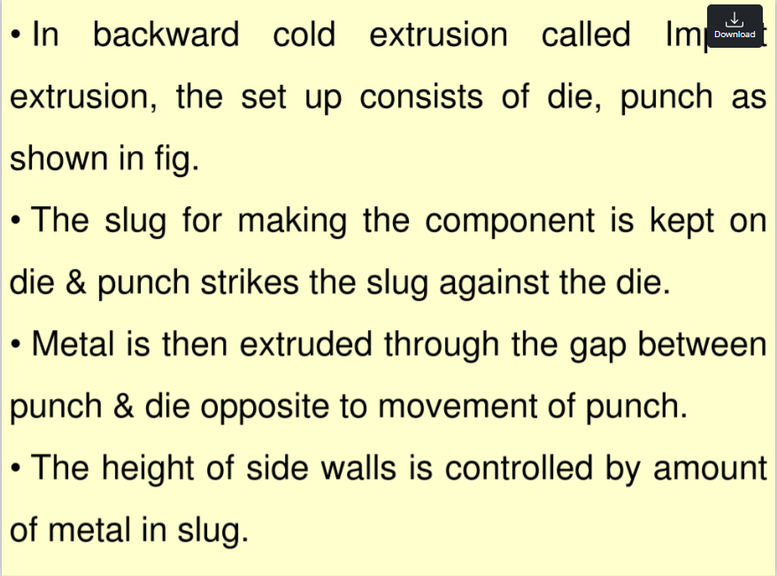

Slide 24
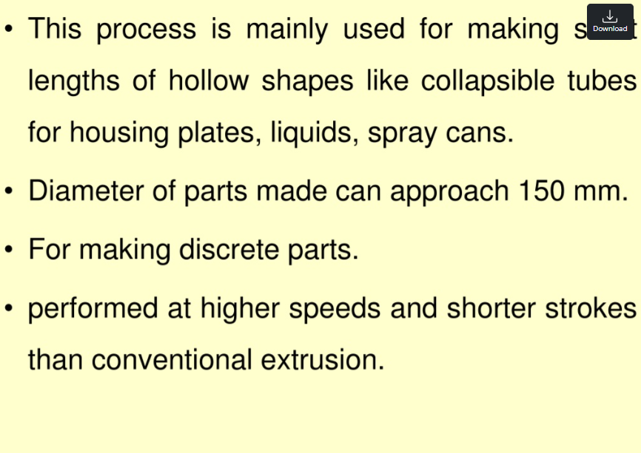

Slide 25
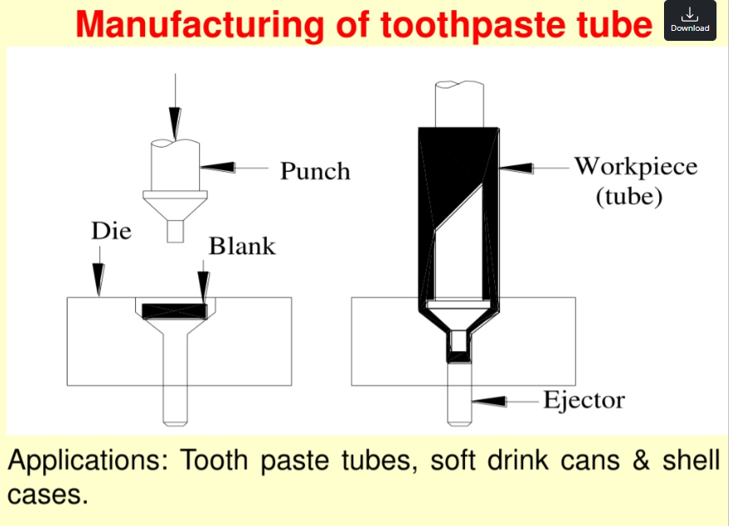

Slide 26
Advantages:
High Production Rate: Impact extrusion is a fast process, making it ideal for mass production.
High Material Utilization: Minimal material wastage compared to machining processes.
Improved Surface Finish: Produces smooth surfaces, reducing the need for further finishing operations.
Strength Improvement: Cold working strengthens the material due to strain hardening.
Complex Shapes: Can produce intricate hollow and thin-walled components.
Reduced Material Costs: Less raw material is required compared to machining.

Slide 27
Disadvantages:
High Initial Cost: Requires specialized dies, tooling, and presses, leading to high initial investment.
Limited Material Selection: Suitable primarily for ductile metals like aluminum, brass, and soft steels.
Die Wear and Maintenance: Dies experience high stress, leading to wear and frequent replacements.
Limited Size and Thickness: Not suitable for very large or thick-walled components.
High Energy Requirement: Requires significant force, especially for harder materials.

Slide 28
Applications:
1. Automotive Industry
Manufacturing of aluminum and steel automotive components such as fuel filters, shock absorber housings, and transmission parts.
Lightweight engine components to improve fuel efficiency.
2. Packaging Industry
Production of aluminum cans and tubes for food, beverages, and cosmetics (e.g., toothpaste tubes, deodorant cans).
Aerosol containers used for perfumes, sprays, and lubricants.
3. Aerospace Industry
Lightweight aircraft components requiring high strength and precision.
Parts used in hydraulic and fuel systems.
4. Electrical and Electronics Industry
Heat sinks for electronic devices.
Battery casings for rechargeable batteries and power cells.

